Slide 1
PLASMA BANK MANAGEMENT
RESONANCE
Madhav Sirsat(001537223)
Shubham Chaudhari(001520219)

Slide 2
OVERVIEW
The database is created to manage Plasma Blood for Covid-19 Patient. It will cater and support the following:
Storing and managing medical details of the Patient
Storing and managing information regarding Hospital
Storing and managing details of the Doctor
Managing Plasma Bank details.
Managing request and withdrawals of Doctor regarding Plasma need
Managing request and withdrawals of Hospital according to Plasma need
Managing information regarding Plasma Bank Inventory

Slide 3
Work Distribution – Phase I(Proposal)
Shubham Chaudhari
Madhav Sirsat
Madhav Sirsat
Problem Statement
Deciding Tables
Defining Keys
E-R Diagram
Business Rules
Problem Statement
Deciding Tables
E-R Diagram
Normalization
Data Dictionary

Slide 4
Work Distribution – Phase II (Implementation)
Shubham Chaudhari
Madhav Sirsat
Creation of Tables
Altering Primary and Foreign Keys
Insert Data in Tables
Addition of Views and Indexes
Addition Stored Procedures
Addition of Functions
Addition of Packages
SQL Reports
Creation of Tables
Altering Primary and Foreign Keys
Insert Data in Tables
Addition of Triggers
Addition Stored Procedures
Addition of Functions
Addition of Packages
SQL Reports

Slide 5
Data Dictionary
User_Credentials
User_Credentials
Column | Data Type | Description | Example
User_ID(PK) | INT(5) | Unique Key to Identify each user. | 11109
Username | VARCHAR(10) | Usernames generated by end users | mssirsat
PIN | INT(6) | Six-digit PIN generated by user to login | 300696
Hospital
Column | Data Type | Description | Example
H_ID(PK) | INT(4) | Unique ID associated with hospitals, Starts with 1 | 1109
User_ID(FK) | INT(5) | Unique Key to Identify each hospital. | 11109
H_Name | VARCHAR(40) | Name of the Hospital | Boston Medical Centre
H_Address | VARCHAR(100) | Address of the Hospital | 111 Huntington Avenue, Boylston St, Boston, MA 02199
H_Phone | INT(10) | Phone number of the hospital | 6176388000

Slide 6
Data Dictionary Cntd.
Patient
Column | Datatype | Description | Example
P_ID (PK) | INT(8) | Unique ID associated with each Patient, first 4 digits correspond to H_ID | 11098324
D_ID (FK1) | CHAR(5) | Unique ID of the doctor treating patient | D0983
User_ID (FK2) | INT(5) | Unique Key to identify each patient. | 48324
P_Name | VARCHAR(40) | Name of the patient | Siddhesh Aher
P_Age | INT(2) | Age of the patient | 24
P_Gender | CHAR(1) | Gender of the patient | M/F
P_Blood Type | VARCHAR(3) | Blood type of the patient | B+
P_STREET_ADDRESS | VARCHAR2(50) | Street address of the patient | 1126 Boylston St
P_CITY | VARCHAR2(15) | City of address of the patient | Boston
P_ZIPCODE | CHAR(5) | Zip code for address of the patient | 02215
P_PH_NO | NUMBER(10) | Phone number of the patient | 9265487445
P_MEDICAL_HISTORY | VARCHAR2(20) | Medical Record of the patient | ASTHMA/HIGH BP/THALSSEMIA etc
P_Status | CHAR(3) | Patient status (Active or recovered) | ACT/REC

Slide 7
Data Dictionary Cntd.
Doctor
Column | Data Type | Description | Example
D_ID(PK) | CHAR(5) | Unique 5-character ID assigned for each doctor working at the hospital, starts with D | D0983
H_ID(FK) | INT(4) | Unique ID associated with hospitals, Starts with 1 | 1109
User_ID(FK) | INT(5) | Unique Key to Identify each doctor. | 30983
D_Name | VARCHAR(40) | Name of the Doctor | Bruce Banner
P_Count | INT(2) | No. patients the doctor is currently treating | 09
Plasma Bank
Column | Data Type | Description | Example
PB_ID(PK) | CHAR(6) | Unique 6-character ID assigned for each plasma bank, starts with PB | PB2389
User_ID(FK) | INT(5) | Unique Key to Identify each plasma bank. | 22389
PB_Name | VARCHAR(40) | Name of the plasma bank | Boston Red Cross
PB_Address | VARCHAR(100) | Address of the plasma Bank | 274 Tremont St, Boston, MA 02116
PB_Phone | INT(10) | Contact number of plasma Bank | 8007332767

Slide 8
Data Dictionary Cntd.
PB_Inventory
Column | Data Type | Description | Example
Bloodbag_ID(PK) | CHAR(10) | Unique ID for each blood bag in inventory, first 6 characters correspond to PB_ID | PB23890018
PB_ID(FK) | CHAR(6) | Unique 6-character ID assigned for each plasma bank, starts with PB | PB2389
Blood_Type | VARCHAR(3) | Blood type corresponding to the blood bag | AB+, O-
Blood_Volume | INT(3) | No. of ml of blood stored in the blood bag | 750
Hospital_Request
Column | Datatype | Description | Example
H_ReqID (PK) | INT(8) | Unique ID generated for each request raised by Hospital, first 4 integers are H_ID | 11094689
H_ID (FK) | INT(4) | Unique ID associated with hospitals, Starts with 1 | 1109
Blood_Type | VARCHAR(3) | Blood type requested | AB+
Request_Amount | INT(3) | Amount of blood in ml requested | 750
Request_Date | TIMESTAMP | Timestamp of the request generated | 2020:16:11 11:20:15
Request_Status | VARCHAR(8) | Status of the request | APPROVED, PENDING, REJECTED

Slide 9
Data Dictionary Cntd.
Doctor_Request
Column | Datatype | Description | Example
D_ReqID (PK) | CHAR(9) | Unique ID generated for each request raised by Doctor, first 5 characters are D_ID | D09834424
D_ID (FK1) | CHAR(5) | Unique 5-character ID assigned for each doctor working at the hospital, starts with D | D0983
P_ID (FK2) | INT(8) | ID of patient for whom the request is generated | 11098324
Plasma_Type | VARCHAR(3) | Blood type requested | AB+
Request_Amount | INT(3) | Amount of Blood in ml requested | 750
Request_Date | TIMESTAMP | Timestamp of the request | 2020:16:11 09:18:23
Request_Status | VARCHAR(8) | Status of the request | APPROVED, PENDING, REJECTED

Slide 10
Data Dictionary Cntd.
Hospital_Withdrawal
Column | Datatype | Description | Example
H_WDID (PK) | INT(8) | Unique ID generated for each withdrawal done by Hospital | 09893620
H_ReqID (FK1) | INT(8) | Unique ID generated for each request raised by Hospital; first 4 integers are H_ID | 11094689
Bloodbag_ID (FK2) | CHAR(10) | Unique ID for each blood bag in inventory, first 6 characters correspond to PB_ID | PB23890018
Withdrawal_Date | TIMESTAMP | Timestamp of the withdrawal | 2020:17:11 08:15:32
Withdrawal _Status | CHAR(7) | Status of the withdrawal | COMPLETE / PENDING
Doctor_Withdrawal
Column | Datatype | Description | Example
D_WDID (PK) | INT(8) | Unique ID generated for each withdrawal done by Doctor | 44240001
D_ReqID (FK1) | CHAR(9) | Corresponding request ID | D09834424
Bloodbag_ID (FK2) | CHAR(10) | Unique ID of blood bag provided to the doctor | PB23890018
Withdrawal_Date | TIMESTAMP | Timestamp of the withdrawal | 2020:17:11 16:32:09
Withdrawal _Status | CHAR(7) | Status of the withdrawal | COMPLETE / PENDING

Slide 11
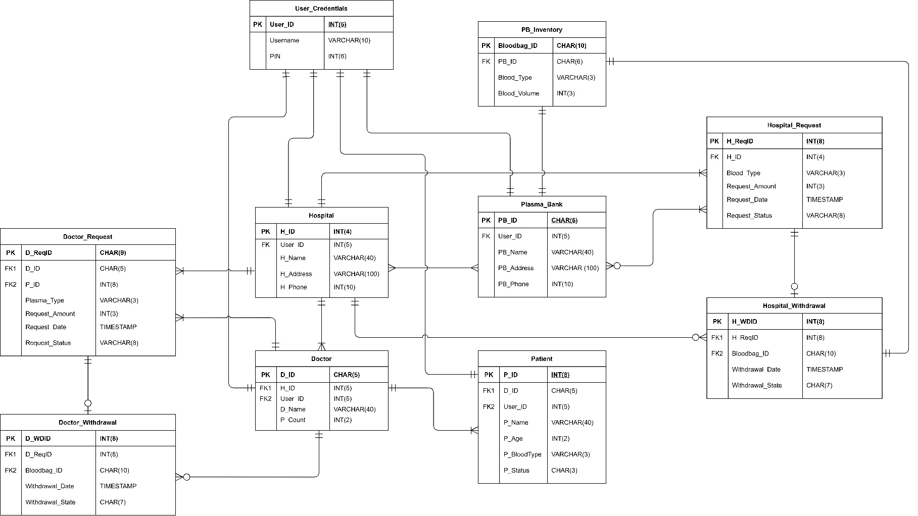
E-R Diagram

Slide 12
Business Rules
Hospital
Each hospital can have many patients, but patient cannot be admitted to many hospitals at same time
Each Hospital can have many doctors, but same doctors cannot work at different hospitals.
Hospital can request plasma to many plasma banks but can withdraw from one bank for same request.
Hospital can have many doctor requests.
Doctor
Each doctor can have many patients, but patient cannot have many doctors.
A doctor can work at one hospital only.
Doctor can send many requests to hospital.
Doctor can withdraw request from hospital.
Patient
Patient can have only one doctor.
Plasma Bank
Plasma banks can have many requests from many hospitals.

Slide 13
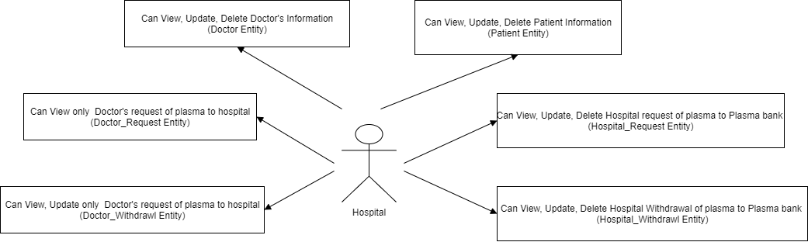
User Level Security
Hospital
Hospital will have admin level of security as shown in following diagram.

Slide 14
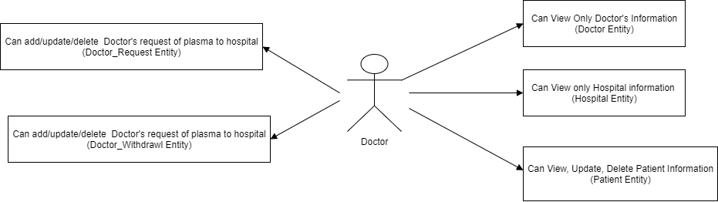
User Level Security
Doctor
Doctors can add/update/delete patient information, request and withdrawal of plasma to hospital as well.

Slide 15
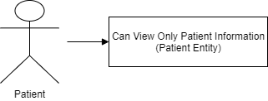
User Level Security
Patient
Patient can only view patient related information.

Slide 16
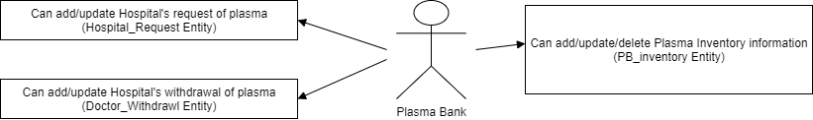
User Level Security
Plasma Bank
Plasma Banks can add/update/delete plasma bank inventory of own inventory and can view/update hospital request and withdrawal.

Slide 17
THANK YOU

